Slide 1
CDMA SLOT 7,8,9

Slide 2
Code-Division Multiple Access
With CDMA the individual carriers may be present simultaneously within the same rf bandwidth, but each carrier carries a unique code waveform (in addition to the information signal) that allows it to be separated from all the others at the receiver.
The carrier is modulated in the normal way by the information waveform and then is further modulated by the code waveform to spread the spectrum over the available rf bandwidth. Many of the key properties of CDMA rely on this spectrum spreading, and the systems employing CDMA are also known as spread-spectrum multiple access (SSMA).
CDMA can be used with analog and digital signals but only digital systems will be described here.
For illustration purposes, a polar non-return-to-zero (NRZ) waveform denoted by p(t) will be used for the information signal, and BPSK modulation will be assumed. The code waveform c(t) is also a polar NRZ signal, as sketched in Fig. What would be called bits in an information wave- form are called chips for the code waveform, and in most practical sys- tems the chip rate is much greater than the information bit rate. The pulses (chips) in the code waveform vary randomly between +V and —V.
The randomness is an essential feature of spread-spectrum systems, and more will be said about this shortly. The code signal may be applied as modulation in exactly the same way as the information signal so that the BPSK signal carries both the information signal p(t) and the code signal c(t). This method is referred to as direct-sequence spread spectrum (DS/SS). Other techniques are also used to spread the spectrum, such as frequency hopping, but the discussion here will be limited to the DS/SS method.

Slide 3
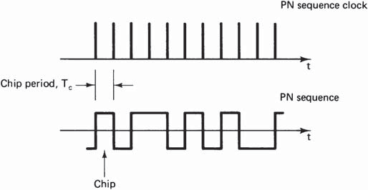
Figure PN binary sequence. One element is known as a chip.

Slide 4
Direct-sequence spread spectrum
p(t) is an NRZ binary information signal, and c(t) is a NRZ binary code signal.
These two signals form the inputs to a multiplier (balanced modulator), the output of which is proportional to the product p(t)c(t).
This product signal is applied to a second balanced modulator, the output of which is a BPSK signal at the carrier frequency.
For clarity, it is assumed that the carrier is the uplink frequency, and hence the uplink carrier is described by
e_{U}(t) = c(t)p(t) cos u_{U}t
The corresponding downlink carrier is
e_{D}(t) = c(t)p(t) cos u_{D}t
At the receiver, an identical c(t) generator is synchronized to the c(t) of the downlink carrier. This synchronization is carried out in the acqui- sition and tracking block.
With c(t) a polar NRZ type waveform, and with the locally generated c(t) exactly in synchronism with the transmitted c(t), the product c²(t) = 1. Thus the output from the multiplier is
c(t)e_{D}(t) = c²(t)p(t) cos u_{D}t
= p(t) cos u_{D}t
This is identical to the conventional BPSK signal and hence detection proceeds in the normal manner.

Slide 5
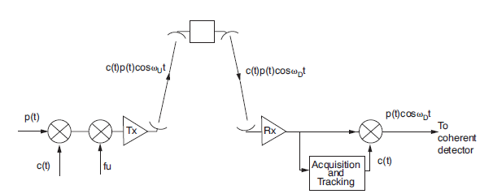
The code signal c(t)
The code signal c(t) carries a binary code that has special properties needed for successful implementation of CDMA. The binary symbols used in the codes are referred to as chips rather than bits to avoid confusion
with the information bits that will also be present.
Chip generation is controlled by a clock, and the chip rate, in chips per second, is given by the clock speed.
Denoting the clock speed by R_{ch}, the chip period is the reciprocal of the clock speed:
Figure A basic CDMA system.

Slide 6

T_{ch} = 1/R _{ch}
The waveform c(t) is periodic, in that each period is a repetition of a given sequence of N chips. The sequence itself exhibits random properties, which will be described shortly. The periodic time for the waveform is
T_{N} = NT_{ch}
The codes are generated using binary shift registers and associated linear logic circuits. The circuit for a three-stage shift register that gen- erates a sequence of N = 7 chips is shown in Fig
Feedback occurs from stages 1 and 3 as inputs to the exclusive OR gate. This pro- vides the input to the shift register, and the chips are clocked through at the clock rate R_{ch}.
The generator starts with all stages holding binary 1s, and the following states are as shown in the table in Fig. Stage 3 also provides the binary output sequence. The code waveform generated from this code is shown in Fig.
Clock
+V
1
2
3
t
+
–V
(b)
1 | 2 | 3
1 | 1 | 1
0 | 1 | 1
1 | 0 | 1
0 | 1 | 0
0 | 0 | 1
1 | 0 | 0
1 | 1 | 0
1 | 1 | 1
0 | 1 | 1
 |  |  | Repeat
(a)
Figure Generation of a 7-chip maximal sequence code.

Slide 7
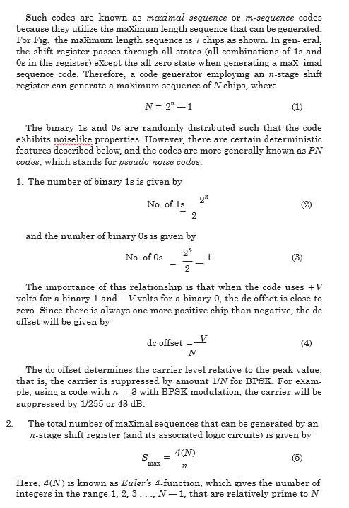

Slide 8
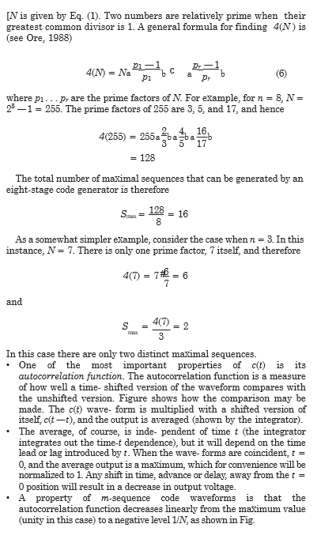

Slide 9
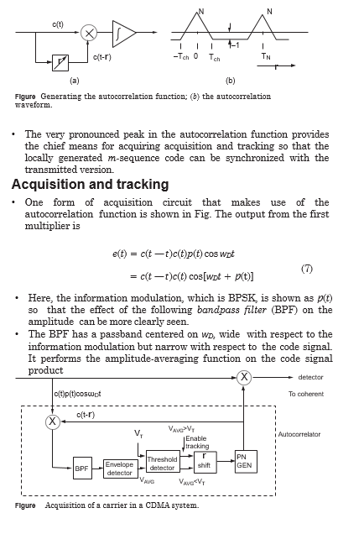

Slide 10

The averaging process can be illustrated as follows.
Consider the product of two cosine terms and its expansion:
2
The BPF will reject the high-frequency component, leaving only the average component 0.5 cos(6). This signal may be considered analogous to the c(t)c(t — t) term in Eq.7).
The envelope detector following the BPF produces an output proportional to the envelope of the signal, that is, to the average value of c(t)c(t — t).
This is a direct measure of the autocorrelation function. When it is less than the predetermined threshold V_{T} required for synchronism, the time shift t incremented. Once the threshold has been reached or exceeded, the system switches from acquisition mode to tracking mode.
One form of tracking circuit, the delay lock loop, is shown in Fig. Here, two correlators are used, but the local signal to one is advanced by half a chip period relative to the desired code waveform, and the other is delayed by the same amount.
The outputs from the correlators are sub- tracted, and this difference signal provides the control voltage for the VCO that drives the shift register clock.
With the control voltage at the zero crossover point, the locally generated code signal is in phase with the received code signal. Any tendency to drift out of phase changes the VCO in such a way as to bring the control voltage back to the zero crossover point, thus maintaining synchronism.
The acquisition and tracking circuits also will attempt to correlate the stored version of c(t) at the receiver with all the other waveforms being received. Such correlations are termed cross-correlations.
It is essential that the cross-correlation function does not show a similar peak as the autocorrelation, and this requires careful selection of the spreading functions used in the overall system (see, for example, Dixon, 1984).
Spectrum spreading and despreading
In general, for a BPSK signal at a bit rate R_{b}, the main lobe of the power- density spectrum occupies a bandwidth extending from f_{c} — R_{b} to f_{c} + R_{b}. This is sketched in Fig. A similar result applies when the modulation signal is c(t), the power-density spectrum being as sketched in fig.

Slide 11
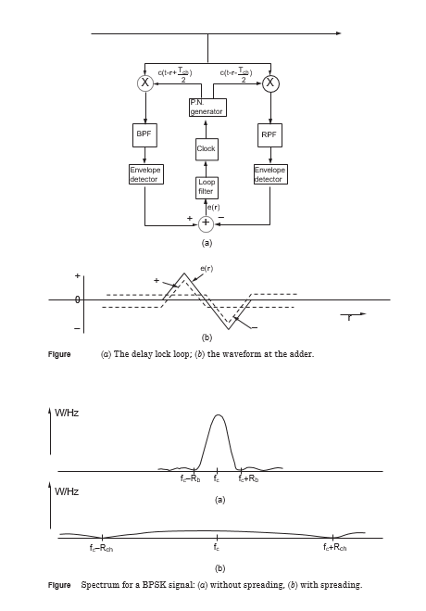

Slide 12
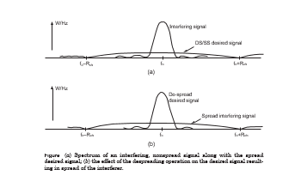
It should be mentioned here that because c(t) exhibits periodicity, the spectrum density will be a line function, and Fig.shows the envelope of the spectrum.
The spectrum shows the power density (watts per hertz) in the signal. For constant carrier power, it follows that if a signal is forced to occupy a wider bandwidth, its spectrum density will be reduced. This is a key result in CDMA systems.
In all direct-sequence spread-spectrum systems, the chip rate is very much greater than the information bit rate, or R_{ch} >> R_{b}.
The band- width is determined mainly by R_{ch} so that the power density of the signal described by Eq. spread over the bandwidth deter- mined by R_{ch}. The power density will be reduced approximately in the ratio of R_{ch} to R_{b}.
Assuming then that acquisition and tracking have been accomplished, c(t) in the receiver performs in effect a despreading function that it restores the spectrum of the wanted signal to what it was before the spreading operation in the transmitter.
This is also how the spread- spectrum technique can reduce interference. Figure shows the spectra of two signals, an interfering signal that is not part of the CDMA system and that has not been spread, and the desired DS/SS received signal.
Following the despreading operation for the desired signal, its spectrum is restored as described previously. The interfering signal, however, is simply multiplied by the c(t) signal, which results in it being spread.

Slide 13
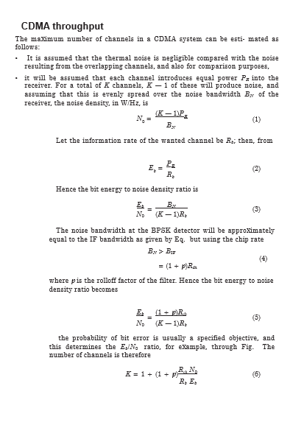

Slide 14
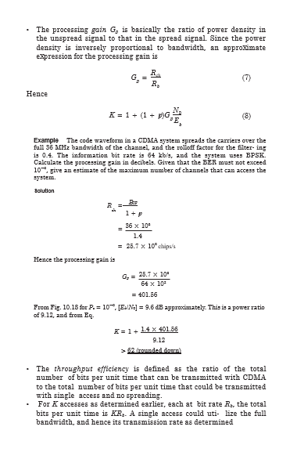

Slide 15
